Slide 1




The digital parenting expert that truly knows your family
Investment pitch · Seed round · 2026
Notes:
Hello, we're Harmonia. We're building digital support for parents of children aged 2 to 17. Open warmly and personally — we're two moms who lived this problem ourselves. Goal of the cover slide: one clear value sentence + a premium, calm impression.

Slide 2





PROBLEM
Parents don't fail the knowledge test. They fail the capacity test. The main trigger is exhaustion, not ignorance (UNICEF, 2025).
Information overload
Help arrives too late
Digital overload. AI, Google, forums, and social media often give conflicting or generic advice.
An expert is available in a week or more, for a minimum of €60. The meltdown is happening now, in the store.
Generic, not personal
Capacity, not knowledge
“One-size-fits-all” advice doesn't account for the child's age, temperament, or specific situation.
Without adequate support, parents of more challenging children lose confidence
02
Notes:
The point: the problem isn't a lack of information — it's a lack of reliable, personalized guidance at the right moment. Emphasize 'help arrives too late' — that's the emotional trigger every parent recognizes.

Slide 3



WHY NOW
Opportunity
The digital parent is the norm
AI enables personalization
Mental health becomes a priority
Parents manage health, finances, and learning through apps. They expect the same for parenting.
Targeted advice tailored to the child's age, temperament, parenting style, and situation.
Parents and institutions increasingly recognize the value of investing in children's emotional resilience
100,000+
Proven concept for parenting apps with expert support — Good Inside (Dr. Becky) has 100,000+ subscribers and ~$34M in annual revenue. Parents are already paying for quality, personalized support.
Source: Fortune, 2026
03

Slide 4
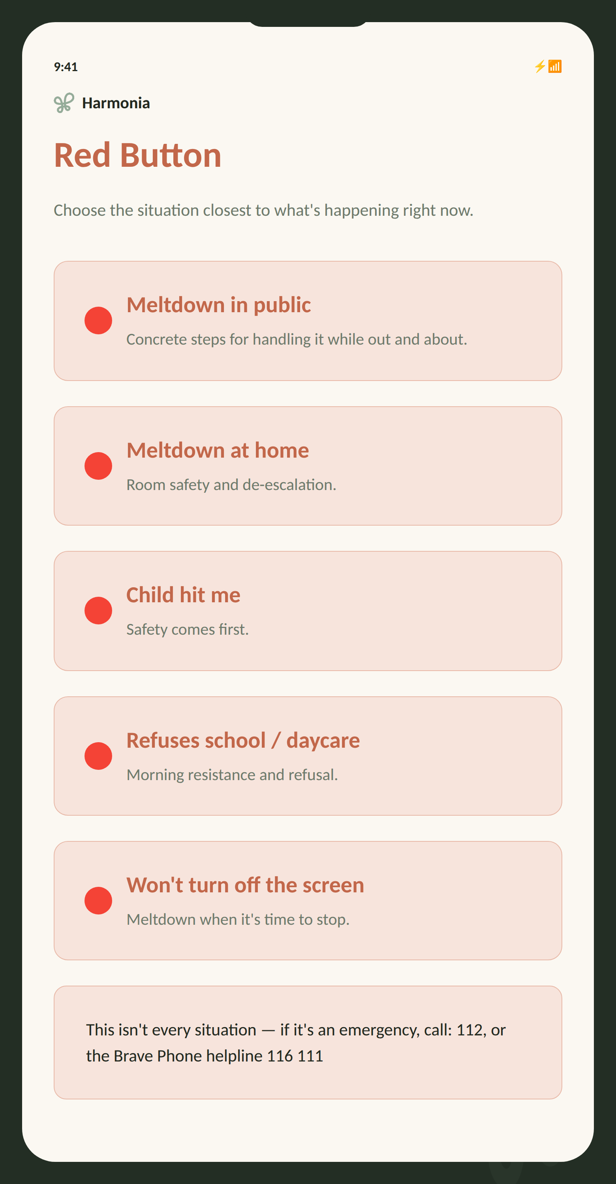






THE SOLUTION · HARMONIA APP
Help in the moment when nothing else works.
Harmonia is an educational B2C parenting app for parents of children aged 3 to 7 (later expanding to ages 2 to 17) that provides hyper-personalized recommendations for everyday parenting challenges. Personalization is powered by our own AI system, which follows a proprietary deterministic decision-making model designed and tested by a psychologist.
Dynamic profile
AI on an expert foundation
Temperament, triggers, and parenting style — built up over time.
Recommendations drawn from the profile and literature curated by a psychologist.
10-day plan + tracking
“Red Button”
Measures whether the strategy is working — no guessing.
Real-time crisis support (a parenting SOS)
Feedback loop from parent “journaling” and pattern analysis
Summary for the specialist
A structured overview for a pediatrician or psychologist.
The parent logs when, with whom, and after what the problem occurs.
The only tool that combines deep personalization, longitudinal tracking, and crisis support. launching in Croatian where there is no similar applications.
04

Slide 5
PRODUCT · PROACTIVE SUPPORT
Every day, the app learns from parent feedback and proactively offers help based on what it learns.
●
The Harmonia app reaches out on its own at key moments of the day.
Morning
Transitions
Play & boundaries
Bedtime
“She cries every morning getting ready. I don’t know what to do.”
“Every pickup from daycare turns into a meltdown.”
“He hits when things don’t go his way.”
“She asks for just one more thing, ten times in a row.”
AI
Learns from patterns and adapts
!
Prevention tip
When Harmonia spots a recurring trigger, it flags the pattern and adjusts suggestions to better fit your child.
Before a typical difficult moment, Harmonia sends a heads-up: “Transition in 15 min — try the countdown trick that worked last Tuesday.”
DATA PRIVACY
All questionnaire and user inputs are anonymized before reaching the AI layer. Harmonia model operates within a closed, deterministically validated recommendation set, and all data handling complies with GDPR and EU regulations on the protection of minors’ data.
05

Slide 6







PRODUCT · PROACTIVE SUPPORT
Every day, the app learns from parent feedback and proactively offers help based on what it learns.
The Harmonia app reaches out on its own at key moments of the day.
→
→
→
Morning
Transitions
Play & boundaries
Bedtime
“Yesterday's morning routine was tough. Try this before breakfast.”
“Time to get dressed. How did it go?”
“Did you set a boundary for XX today and hold it after your child pushed back?”
“Getting ready for bed. Was tonight calmer?”
Learns from patterns and adapts
Prevention tip
Three days without a response → the app asks what's going on and adjusts the plan.
Along with the check-in, it offers a concrete move based on what has worked for that child so far.
Result: The more the app is used, the more precise its recommendations become, making Harmonia an increasingly valuable source of support for parents.
05

Slide 7






PRODUCT · CONTEXTUAL PERSONALIZATION
We combine the child's interests with environmental signals into a single suggestion.
Additional data is gradually gathered during use
+
+
+
Nature & animals
Water & the park
Weather forecast
Pollen & air quality
“Whether the child enjoys being outdoors and what their favorite animal is.”
“Whether they like water and have a favorite park or playground.”
“When it's sunny, the suggestion goes outdoors; when it rains, it moves inside.”
“High pollen count or poor air quality → an indoor alternative is suggested.”
UV radiation
Location while in use
When the UV index is high, the suggestion adapts to less time outside, or time in the shade.
Used only while the app is open, so the suggestion fits what's actually available nearby.
Result: High level of personalization working seamlessly in the background. For example, if a child’s favorite animal is a dog, we can incorporate it into activity suggestions or we may also recommend an activity at a nearby park, swimming pool, or other suitable location that child and family likes.
05

Slide 8
HOW IT WORKS
From uncertainty to a calm decision, in just a few steps.
1
→
2
→
3
→
4
Set up the intake profile
Describe the situation
Get guidance
Track progress
Age, temperament, and goals for each child.
Choose the key parenting issues, or press the Red Button for immediate support.
Concrete steps from an expert-built knowledge base: what to say and do.
Log what works and what doesn't, and why; Harmonia learns about your family.
EXPERT FOUNDATION & VALIDATION
“RED BUTTON” · IN REAL TIME
AI builds recommendations from the intake profile based on a proprietary deterministic model and decision tree designed by a psychologist. As the app is used, additional information about the child, family, and external factors is gathered, which the AI combines for maximum personalization built around the core deterministic recommendations.
For a known class of problems, a deterministic expert system provides a validated guideline in 2–3 seconds, for crisis and high-stress situations. Only recommendations validated by a psychologist 100% enter the “Red Button” pool (it will also work offline)
05

Slide 9
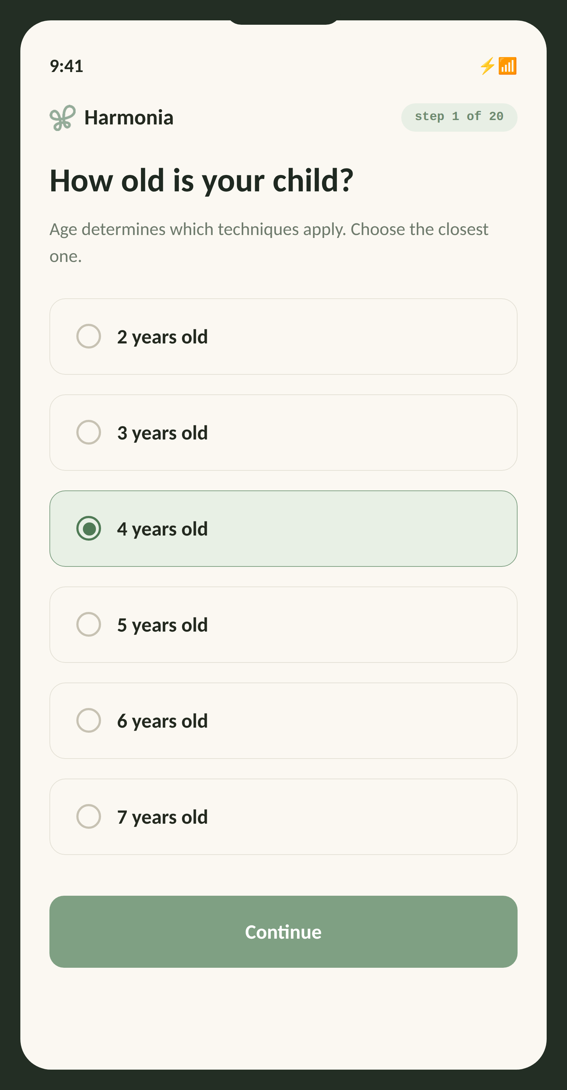
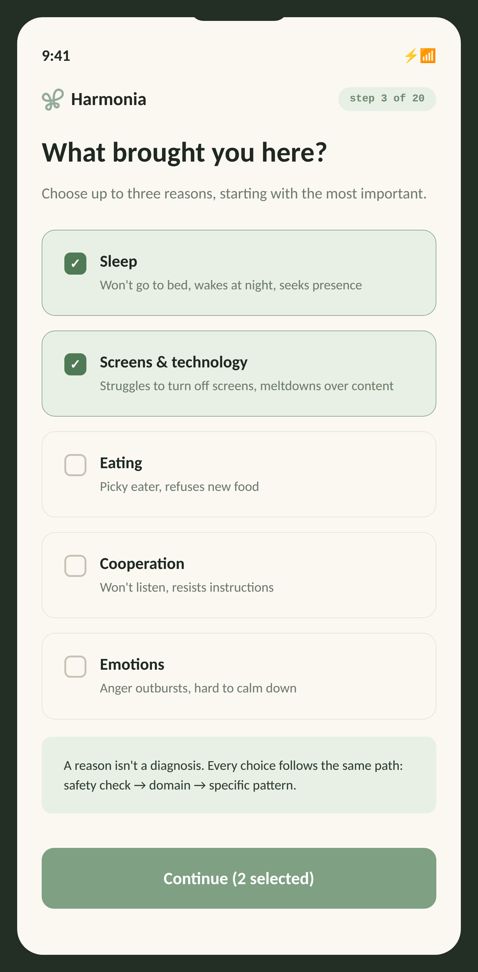
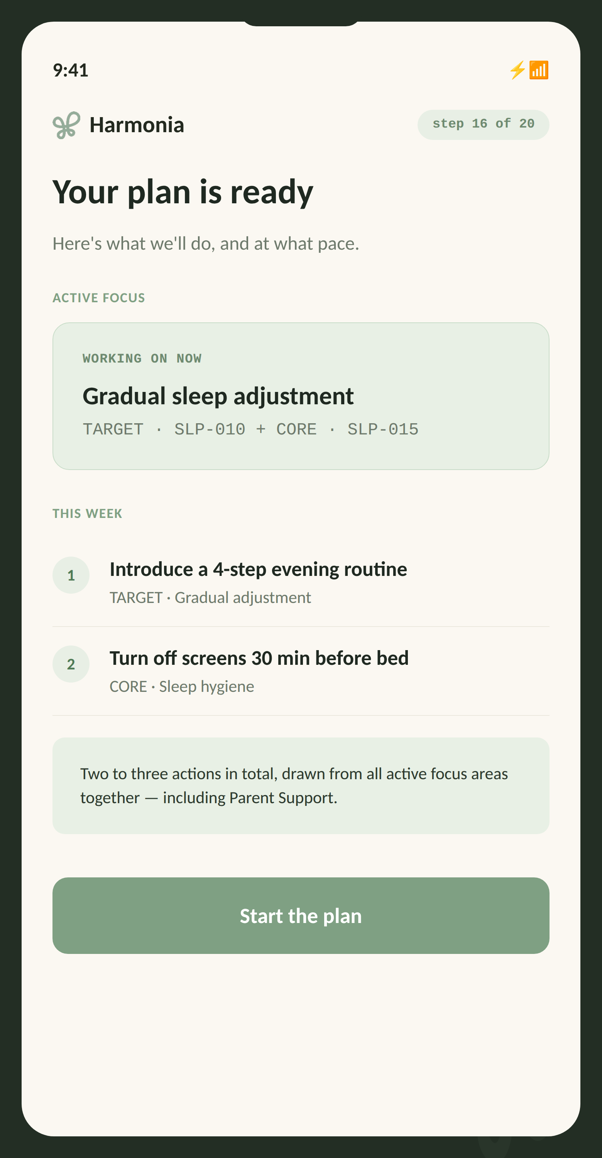
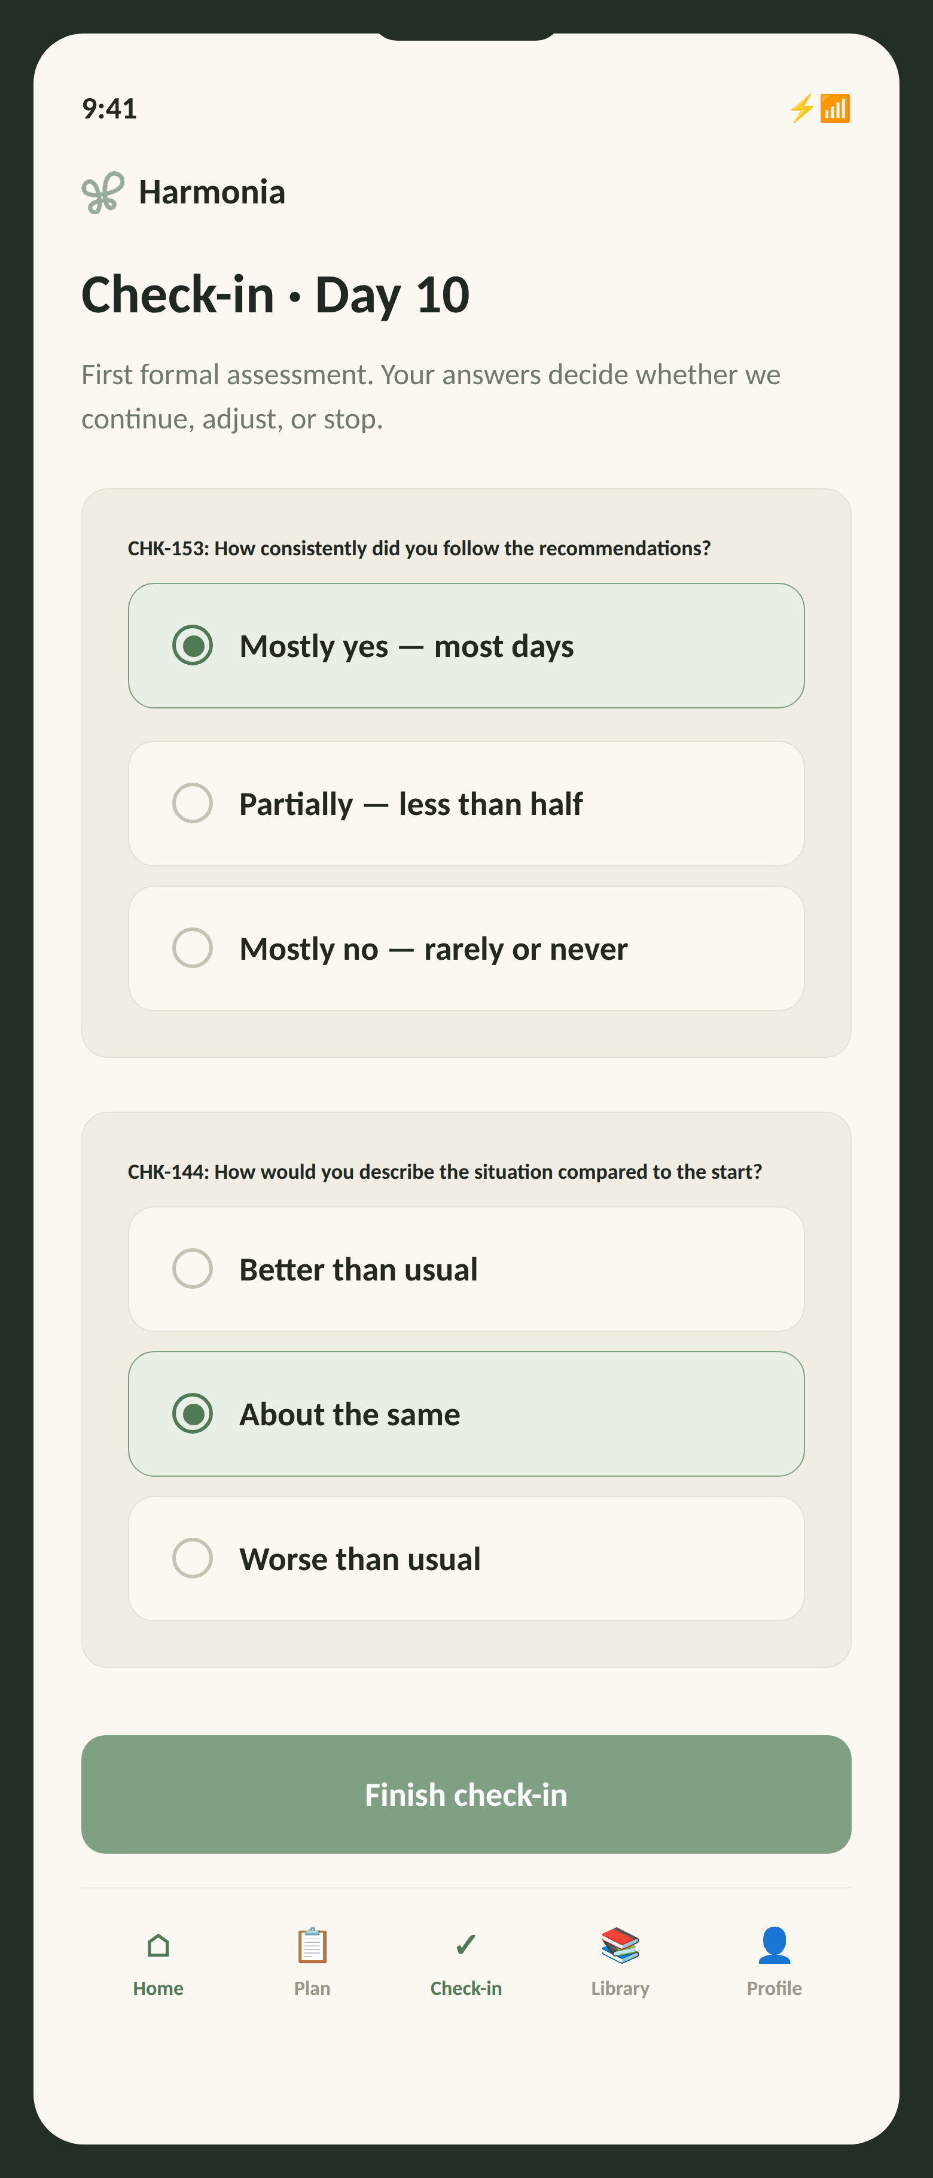
PRODUCT · APP SCREENS
This is what it looks like in the app.
1 · Set up your profile in
about 20 questions
2 · Describe your family's situation
3 · Get guidance
4 · Track progress
05

Slide 10
COMPETITION
How Harmonia plans to stand out.
Product | Approach | Trade-off | Harmonia’s planned advantage
Good Inside | Dr. Becky’s expert method, content library, parent community and GiGi AI chat with voice. | Chat guidance starts with a parent’s question and the context they provide. | Deep family profile: structured answers about the child, family dynamics and parenting style inform a continuing plan.
Joy | Expert-trained AI plus 24/7 access to certified parent coaches. | Live coaching involves expert time; service capacity must support demand. | Software-led delivery: expert-authored rules guide everyday plans. Initial focus: ages 3–7, with broader coverage planned.
MissPoppins | Marketplace for one-to-one coaching sessions and packages, also offered through employers. | Each booked session requires a coach’s time and availability. | A daily plan: ten-day cycles, check-ins and referral when specialist support is needed.
Harmonia | Planned family profile, daily check-in and ten-day review: continue, adjust or refer. Planned HR price: €8.99/month. | Beta in development. Usefulness, retention and delivery costs will be tested in the pilot. | One continuing process: structured intake, expert decision rules and family feedback in a software-led plan.
Official product sources checked 9 October 2026: goodinside.com · joy.co and Joy Help Center · misspoppins.io. Trade-offs are our assessment; Harmonia features and advantages are planned and will be tested in the pilot.
06

Slide 11



WHO WE BUILD FOR
We support parents through most of their child's upbringing.
Early years · 2–6
School age · 7–12
Adolescence · 13–17
Meltdowns, boundaries, sleep, adjusting to daycare, and independence.
School and motivation, screens, friendships, confidence, and emotions.
Mental health, autonomy, risk, communication, and trust.
Primary user: moms aged 25–45, digitally literate, actively seeking quality, targeted parenting content.
Secondary: parents and primary caregivers; daycares, schools, and clinics as a B2B channel.
07
Notes:
Key point: one subscription follows the child through every stage → long customer lifetime. More children per family = higher value. Mention that the broad 2–17 range extends the subscription for years.

Slide 12
MARKET OPPORTUNITY
A growing category of parenting apps
TAM ~94M households · DACH + English, 2–17
≈ $1.8B
SAM ~1.8M households · Croatia & region, ages 2–17
Global market today parenting apps, 2025.
STARTING POINT
≈ $5–6B
~140,000 Croatian households, children 3–7
2035 projection CAGR ~11–12% (multiple sources)
≈ 1%
Harmonia’s share of global market
€52.7M revenue in 2035 (≈$57M)
Starting point: ~140,000 Croatian households with a child aged 3–7 (Croatian Bureau of Statistics, live births 2019–2023). Expansion: ~1.8M households in Croatia & the region; ~11M in DACH; 83M+ English-speaking. Bottom-up funnel (S2): ~342,000 premium subscribers · ~2.1M total users · €52.7M revenue in 2035. Market share: €52.7M ÷ $5.5B ≈ 1%. Break-even: ~4,830 paying users at €8.99 (covers 2028 costs), or ~3.5% of the starting point.
08

Slide 13




GO-TO-MARKET
We're building audience and trust ahead of the app
PHASE 1
PHASE 2
PHASE 3
1
2
3
Croatia + region
German-speaking (DACH)
English-speaking
Native language, low CAC. Campaign from month 5 of the seed (first 3 months: channel warm-up); 80% paid ads, 20% ASO and referrals.
Interest test in mo. 9–12, then a test in Austria and Germany in H1 2028 with a small UK + Ireland test; entry 2029 where CAC is better.
UK + Ireland from 2030, then the US. Nordics, NL, Singapore, UAE: test 2029, entry 2030 if CAC ≤ DACH. Japan & Korea 2032+
Acquisition channels
B2B
Digital channels
Pediatricians/psychologists and partner associations
Influencers
12
Notes:
Our unfair advantage: the team already runs Harmonia workshops in schools (pilot at A. Šenoa Elementary, 100+ children) — these are ready-made trust channels for launching the app. Native language = low CAC in the first phase.

Slide 14
GEOGRAPHIC EXPANSION
From native language to global reach.
PHASE 1 · 2027–28
PHASE 2 · 2028–31
PHASE 3 · 2029+
Croatia and the region
German-speaking (DACH)
English & high-value
Croatia
Austria (test 2028)
UK + Ireland (2030)
Serbia
Germany (test 2028)
US + Canada · ANZ
Bosnia & Herzegovina
Switzerland (German)
Nordics + NL (test 2029)
Montenegro
Diaspora in DE & AT
Japan & South Korea (2032+)
Native language, low CAC, existing trust channels (workshops, pediatricians, daycares, and corporations).
Interest test in mo. 9–12, test in H1 2028 with a small UK + Ireland signal test; entry 2029 where CAC is better.
The English version exists from the 2028 test. High-value markets tested in 2029; entry in 2030 only if CAC ≤ DACH. Japan and Korea with localisation.
13
Notes:
Geo story: we are not trying to conquer the US or take on costly localization right away. Phase 1: the region (language advantage). Phase 2: the German-speaking market (DACH). In German there is no direct competitor offering personalised in-the-moment support; Good Inside only has a translated book, and Meta CPMs are comparable to the UK. We run an interest test in months 9–12 (landing page and waitlist, €1.5K); only if it shows a signal do we localise into German (€6.5K) and test in Austria and Germany in H1 2028 (€7K of ads). In parallel, a small UK + Ireland signal test (€2.5K) gives us an English CAC as well. We enter in 2029 wherever CAC is better. Phase 3: the English-speaking market from 2030 and the high-value markets: we test the Nordics, the Netherlands, Singapore and the UAE in 2029 on the English version and enter in 2030 only where CAC is at DACH level or better. Japan and South Korea come 2032+, with their own localisation budget and a local partner. Capital discipline: we pay for localisation only once there is a signal.

Slide 15
VALIDATION & PLAN
A team that tested the workshops live is now digitizing them.
EXPERT FOUNDATION
10+
years of experience from Tihana Starčević, developmental psychologist
Plus: Workshops delivered to 100+ children in the 2025/2026 school year (A. Šenoa Elementary).
Beta before the seed round. During beta, the AI runs through simulated scenarios and the psychologist reviews the decision tree.
Plan and decision gates
Fall 2026
Mo. 1–6 · 2027
Mo. 5–7 · 2027
Mo. 8–18
Beta and internal testing with AI, self-funded
Seed: 100 families (20/30/50) + blind review; decision in June
Campaign start; channel warm-up
Scaling + DACH and UK/IE tests (mo. 9–18)
14
Notes:
Clearly separate the two: the workshops = real, proven validation of the team and brand (100+ children, pilot). The app = still in development, plan starts with the MVP at the end of 2026. Don't blur the two — be honest and clear. That builds investor trust.

Slide 16
HARMONIA / SEED VALIDATION
What the first 18 months must establish
Management validation targets, not achieved results. M1–M18: January 2027–June 2028. Targets apply to cohorts with enough follow-up; feasibility must be tested.
Measure | By M12 | By M18
Trial → two payments | ≥20% of started monthly trials | ≥25% of started monthly trials
First payment / first monthly renewal | ≥35% of trials / ≥60% of first payers | ≥40% of trials / ≥65% of first payers
Cumulative paid retention | Report the first three renewals | ≥40% after 3rd renewal; ≥25% after 6th
Parent-reported usefulness | ≥70% ratings of 4–5/5; ≥70% response | Same target; include families that cancel
Meaningful use before renewal | Establish the baseline | ≥50% of renewers active in the prior 15 days
Refunds of initial charges within 30 days | Track counts and reasons | ≤3%; investigate above 5%
Croatian channel CAC / observed payback | ≤€25 as a learning milestone | About €18 or less; payback within 9 months
Active paid base and MRR | Monthly new, renewed and lost subscriptions; MRR | About 1,200 active payers; validate in a monthly model
The financial base keeps its conservative 10% conversion assumption. Operational targets of 35–40% do not automatically increase the revenue forecast. The existing 1,201-payer ambition still needs monthly cohort validation.
harmonia.orka.solutions/investor/#seed-kpis

Slide 17
HARMONIA / SEED VALIDATION
How to read opt-out subscription evidence
Trial denominator
Payment timing
All started monthly trials with future billing authorised, including early cancellations. Free pilot cohorts 20 + 30 are excluded.
First charge ≈D20; first renewal ≈D50. Read two payments 14 days later (≈D64–65), net of refunds at that date; update later refunds. Actual due dates govern.
Cumulative retention
Real use and usefulness
Third renewal = fourth charge. Keep the original first-payer denominator with sufficient follow-up. Show annual plans and reactivations separately.
Count plan application or a substantive check-in in the prior 15 days. Report all-payer activity too. Survey at D20 and after the first paid month; include dropouts and response counts.
Transparent opt-out
Observed payback
Card at entry; 20-day trial; reminder three days before billing; easy cancellation. Automatic charges alone do not prove satisfaction.
Recover matched acquisition spend from actual cohort contribution after tax, fees, refunds, AI, infrastructure, variable support and associated trial costs. Include churn.
Targets are management choices informed by subscription research. The reference populations differ; none is a specific benchmark for Croatian AI parenting. Feasibility depends on Harmonia’s observed cohorts.
harmonia.orka.solutions/investor/#seed-kpis

Slide 18
HARMONIA / SEED VALIDATION
Evidence builds in three stages
M1–M6 · Pilot
M7–M12 · Repeatability
M13–M18 · Retention and economics
100 families (20 + 30 + 50), D20 ≥40% and the existing expert and safety checks. The 50-family paid cohort provides a directional signal; no new payment threshold automatically fails the pilot.
Aim for ≥100 first payers across three consecutive monthly cohorts; assess only renewals that are due. Acquisition starts in M5, warm-up runs M5–M7 and optimised HR starts in M8. M11 funding discussions use evidence available then.
Aim for ≥200 first payers observed through the third renewal across ≥3 cohorts, and ≥100 with enough follow-up for the sixth. These are practical data goals, not statistical guarantees. Report DACH and UK/Ireland tests separately.
The pilot’s main usage measure remains ≥40% active on day 20. The existing ≥60% activation threshold means reaching the first daily check-in, not proving benefit. Track profile, plan, check-in, attempted application and reported usefulness separately, including timing in the first seven days. Test their link to D20 and renewal; there is no new 48-hour target.
Monthly subscription revenue
A measured path to better economics
MRR comes from active subscription contracts; spread annual amounts over 12 months and state tax and discount treatment. Show cash receipts separately. One-off packs, B2B projects and consultations are not MRR.
The €25 channel CAC milestone is a learning step, not proof of profitability. About €18 and observed payback within nine months must be supported by retention and costs; they do not establish whole-business profitability or an LTV/CAC of 3×.
harmonia.orka.solutions/investor/#seed-kpis

Slide 19




REVENUE MODEL
20-day trial and subscription (B2C, B2B and B2B2C)
REVENUE STREAMS
ANNUAL REVENUE
Subscription (B2C)
total revenue from all streams · scenario S2
€52.7M
€8.99 Croatia & region · €19 DACH & English markets, monthly / annual
€37.1M
B2B institutions
€23.6M
Daycares, schools, and clinics license access
€13.2M
Corporate HR benefit
€6.3M
Wellbeing package for employees who are parents
€2.4M
€718K
Content & consultations
€38K
€199K
Themed programs, 1-on-1 video consultations
’27
'28
'29
'30
'31
'32
'33
'34
'35
BREAK-EVEN
~4,830 payers
at €8.99, covers 2028 costs · ~3.5% of starting point
€52.7M
Revenue 2035
total annual revenue
93%
B2C subscription
recurring revenue share
342K
premium subscribers
from 775 in 2027
09
Notes:
Subscription is the core; B2B (daycares/schools/clinics) and the corporate benefit extend reach at a low CAC. Prices sit below Good Inside (~€20). Seed unit economics are deliberately conservative: we count a subscription lifetime of only 4 months (the category average is 12), so LTV is €20.14. The campaign starts in month 5; the first three months are a deliberate channel warm-up at ~€45 per paying user (0.54x). From month 8 the planned funnel gives LTV:CAC 1.14x — every paying family earns its CAC back in ~3.5 months. The main risk is the 4% CTR in the funnel: if paid CAC goes above €2.39, the ratio falls below 1.0x. That is why we diversify channels from 2028 (paid ads drop from 80% to 35% of new users). After the seed, lifetime grows to 12–24 months; LTV:CAC reaches ~3.0x in 2030 (2.99x), passes it in 2031 and reaches 6.9x in 2035, with payback staying under 5.2 months every year. We test the German-speaking market (DACH) in H1 2028, alongside a small UK + Ireland signal test, and enter from 2029 (paid CAC €22).

Slide 20
UNIT ECONOMICS
Planned unit economics — seed and scaling
SEED · 18 MO campaign from mo. 5 · warm-up mo. 5–7 at €37 per payer (0.54x) · planned funnel from mo. 8:
CPM
€5
→
CTR
4%
→
Click → trial
6%
→
Paid cost / trial
€2.08
Cost / registration*
€1.88
CAC per payer = channel spend ÷ new paying customers
LTV = net price × lifetime × gross margin
€27,625 ÷ 1,541 = €17.92
€7.19 × 4 mo. × 70% = €20.14
1.12x
LTV : CAC
3.56 mo
Simple payback
Excludes churn
€2.39
paid-CAC ceiling
AFTER SEED · 2028–2035 key metrics · lifetime 12 → 24 mo. · DACH test 2028, entry from 2029
LTV : CAC by year
6.9x
€231
LTV per payer, 2035
€64 in 2028
3.0x
~€34
CAC per payer, 2035
incl. DACH/English markets (paid €22)
1.12x
3.5 mo
CAC payback, 2035
max 5.2 mo (2030)
seed
'28
'29
'30
'31
'32
'33
'34
'35
HR optimized phase: channel spend €27,625 / 1,541 new payers = €17.92 CAC. HR contribution LTV = €8.99 / 1.25 × 70% × 4 = €20.14; LTV/CAC = 1.12x. Channel CAC excludes staff, fractional CMO and founder time. Simple payback = 3.56 months. Figures are planning assumptions; later years are a separate scenario.
10

Slide 21

F I N A N C I A L S U M M A R Y
Path to profitability: 2026–2035
2030
★ EBITDA break-even 2030
● Cumulative payback 2030
EBITDA break-even (first positive year)
2030
Cumulative payback: capital recovered
≈ €52.7M
Projected 2035 revenue
~76%
EBITDA margin at maturity (2035)
Net result is negative during the investment phase (2027–2029). Seed: validation with 100 families in mo. 1–6, campaign from mo. 5 (first 3 months channel warm-up, ~€45 per payer), then a paid-ads CAC of €2.08 (CPM €5, CTR 4%, CvR 6%); ~17,600 new users during the seed. Funding: €350K seed (January 2027) + €1.0M growth round. Distribution fees and customer support costs are included.

Slide 22
F I N A N C I A L S U M M A R Y · D E T A I L
The first six years: revenue, costs, and investment.
€350,000
Seed round · 18 mo. (January 2027 – June 2028)
€1,000,000
Growth round · DACH, then English (2029)
Break-even 2030
Cumulative payback 2030
~€0.29M
Deepest cumulative deficit (2029) · capital coverage 4.65x
Beta before the round. The seed covers validation with 100 families (mo. 1–6), acquisition from mo. 5, a DACH test and ~17,600 new users; next round November 2027.

Slide 23
SEED FUNDS ALLOCATION · €350,000 · 18 MO.
€350,000 to test the model and start acquisition
CATEGORY
AMOUNT
SHARE OF ROUND
TEAM
Two co-founders, full-time, 18 months.
€143,172
40.9%
MARKETING
Fractional CMO (1 day/week), acquisition & social staff, ads HR €24,650, DACH + UK/IE test €11,000, ASO.
€107,350
30.7%
DEVELOPMENT & INFRASTRUCTURE
Full-stack/AI dev 50% from month one; CTO on equity, no salary; EN & DE localisation; servers.
€61,500
17.6%
QA, LEGAL & OVERHEAD
Blind review, supervision, analysis, data protection, contracts, bookkeeping and tools.
€28,500
8.1%
RESERVE
2.7% of the round - buffer for channel warm-up and CAC deviations.
€9,478
2.7%
Marketing & acquisition (incl. fractional CMO): €107,350 = 30.7% of the round. Break-even 2030, 4.65x capital coverage.
HARMONIA · 19

Slide 24
C O S T S T R U C T U R E
Major costs: breakdown 2026–2031
Cost (€) | 2026 | 2027 | 2028 | 2029 | 2030 | 2031
Salaries — founders & team | – | 95,448 | 112,000 | 280,000 | 420,000 | 620,000
Development — developer (50%), team from 2029 | – | 44,500 | 34,000 | 40,000 | 48,000 | 78,000
Marketing & acquisition (by channel + CMO) | – | 59,675 | 123,603 | 295,718 | 863,919 | 1,876,113
Infrastructure + AI (hosting & compute) | – | 4,000 | 12,000 | 70,379 | 170,865 | 339,606
General & administrative (G&A) | – | 9,000 | 10,000 | 47,059 | 157,455 | 405,412
Localization (DE) | – | – | – | 8,000 | – | –
TOTAL OPERATING COSTS | – | 212,623 | 291,603 | 741,156 | 1,660,240 | 3,319,131
Amounts in € (rounded). Beta is self-funded — 2026 is not part of the seed budget; investor-funded costs start in 2027. Of the €59,675 marketing in 2027: €17,750 in paid ads HR (campaign from mo. 5, first 3 months warm-up, then CAC €2.08), €775 ASO and €1,500 for the DACH interest test, ~7,750 new users; the rest covers the acquisition and social media staff, the website, and a fractional CMO (€15,600). Other channels (influencers, trust partners) from 2028.
Founder-funded beta with partner contributions. The final value of pre-round contributions is being reconciled.

Slide 25
TEAM
One mum who knows business. One who knows children & families. Combined into one product
SŠR
TS
IL
Sven Špehar Rajević
Tihana Starčević
Ivan Lozančić
CEO · Co-founder
Chief Clinical Officer · Co-founder
CTO
Economist with 20+ years of experience in business development, marketing, and project management; the last 8 years in IT, mostly with SaaS products. For the past year, has been piloting Harmonia emotional-resilience workshops with 100+ children. Mother of one.
Psychologist with 10+ years of experience working with children and families in crisis situations, including at SOS Children’s Village and Osijek University Hospital. Currently training as a CBT psychotherapist and author of the handbook Steps Through the Storm. She ensures the clinical grounding of the content and serves as the face of the brand. Mother of one and stepmother of three
Co-founder and CEO of Gauss, an Osijek software company of 60+ engineers building AI-driven business platforms (Gauss Box, ORKA ERP) for clients in 20 countries; Deloitte Technology Fast 50 CE. Owner of the Gaudeamus private gymnasium. Leads Harmonia's engineering and AI architecture.
The Full stack dev & AI expert will take over all beta refinements under Ivan’s technical leadership.
ADVISORS
Ante Magzan
Krešimir Vrhovčak
AM
KV
Founder of Afekt. Co-founder of Iskon, T-portal, and MAXtv. Co-founder of HUB385, mentor at Nuqleus.
Krešimir has more than 20 years of rich experience in business analysis, software development, and managing software development teams. He is a software solutions architect with experience preparing, applying for, and running R&D projects
Notes:
This is the 'why us' slide. Authentic story: Sven came to Tihana for advice about her daughter (both moms of 4-year-old girls), and that's how Harmonia was born. Tihana provides clinical credibility; Ivan brings an engineering organisation — he co-founded and runs Gauss (60+ engineers, Osijek and Zagreb, clients in 20 countries, Gauss Box and ORKA ERP, ISO 27001), owns the Gaudeamus gymnasium where the curriculum is AI, programming and XR, and advises the board of the MPR communications agency. Krešimir stays on as technical advisor. Mention that you're building both the team and the advisor bench.

Slide 26




CALL TO PARTNER
We're looking for a seed partner to build and launch.
€350,000
Beta complete → validation
Expert team
seed round · 15% · €1.98M pre-money
18 months, January 2027 – June 2028
with proven in-person track record
info@harmoniaworld.net · harmoniaworld.net
Notes:
Close warmly and clearly: we're looking for a seed partner (€350K, approximate) for the MVP and launch in Croatia/the region. Return to the mission — every parent deserves reliable support. Invite them to talk. The amount is indicative and open to negotiation.

